Slide 1
Introduction
Mobile App Programming
Spring, 2022
Notes:
OK, Let’s start the first lecture of Mobile App Programming course. I’m your TA Lee Seongho .

Slide 2
Introduction of TA

Slide 3
About Teaching Assistants
CSI Labortory
TA. Seunghwan Jeong
TA. Seongho Lee
TA. Mukyo Jeong
TA. Seongmin Kang
Contact
map.at.skku@gmail.com
Office
Cooperation and Collaboration Center #85553 (5th floor)
ICAMPUS for questions
When you have a question, use the question tab on i-Campus.
Do not send i-Campus direct messages to TAs.
Notes:
In this semester, you may meet four different TAs, including me.
We are all belonging to Computer Network laboratory, which is located in Cooperation and Collaboration Center.
And like other courses do, we run the google sheet for Q&A. So, if you have a question, freely write on that sheet. We try to answer you ASAP.

Slide 4
Course Overview
Notes:
So, the next is course overview

Slide 5
Class Overview
Weekly Assignments
Each weekly assignment will be uploaded at the lecture time, and students must submit them until 23:59:00 on that day. (Ex, If the lecture is on Monday, students must submit it until 23:59:00 on Monday.)
Offline Lecture
All lectures will be performed offline.
There are no online classes. All students must come to the classroom.
Notes:
There’re four parts for your grades. 10% for Attendance, 20% for Lab practice, 30% for 2 individual Assignment (it means that 15% for each. ) and 40% for team project.
I will check your attendance 15 minutes later after the class is stared, so after 15 minutes you will get lateness, and You will get F grades, when you absent more than 4 times.
And every week I’ll give you a simple exercise, called lab practice. So you have to submit this exercise until the midnight.
We have two individual assignments, but we still discuss about assignments contents, so it will be announced later.
The last thing is team project.

Slide 6
Offline Classroom
SWE3047-41 (Tue, Prof. Ikjun Yeom)
Cooperation and Collaboration Center 85713, 18:00 ~
SWE3047-42 (Tue, Prof. Younghoon Kim)
Cooperation and Collaboration Center 85718, 18:00 ~
SWE3047-43 (Wed, Prof. Younghoon Kim)
Cooperation and Collaboration Center 85718, 18:00 ~
Notes:
There’re four parts for your grades. 10% for Attendance, 20% for Lab practice, 30% for 2 individual Assignment (it means that 15% for each. ) and 40% for team project.
I will check your attendance 15 minutes later after the class is stared, so after 15 minutes you will get lateness, and You will get F grades, when you absent more than 4 times.
And every week I’ll give you a simple exercise, called lab practice. So you have to submit this exercise until the midnight.
We have two individual assignments, but we still discuss about assignments contents, so it will be announced later.
The last thing is team project.

Slide 7
Grading factors
Attendance : 10%
We will check attendance in offline class.
If you are absent more than 4 weeks, you will get ‘F’ grade
We will check for lateness 15 minutes after class start.
(2 lates = 1 absence)
Lab practice (Weekly Assignment) : 20%
Lab practice must be submitted until 23:59:00 on the lecture day.
Quiz (Tentative) : 20%
If we don’t have a quiz, 20% will be included in the assignment score.
2 Assignments + 1 Project : 50%
Ratio of each assignment is 25 : 35 : 40.
All assignments are for individuals.
Notes:
There’re four parts for your grades. 10% for Attendance, 20% for Lab practice, 30% for 2 individual Assignment (it means that 15% for each. ) and 40% for team project.
I will check your attendance 15 minutes later after the class is stared, so after 15 minutes you will get lateness, and You will get F grades, when you absent more than 4 times.
And every week I’ll give you a simple exercise, called lab practice. So you have to submit this exercise until the midnight.
We have two individual assignments, but we still discuss about assignments contents, so it will be announced later.
The last thing is team project.

Slide 8
Lecture Schedule (Tentative)
Week | Subject | Week Assignment | PA
1 | Orientation & Development environment settings | 1 |  | Android
2 | Basic of Android | 2
3 | Basic Layout, View | 3
4 | Advanced Layout, View | 4 | 1
5 | Activity, Intent, Broadcast | 5
6 | Threading, Asynctask | 6
7 | Networking, HTTP Connection | 7 | 2
8 | Application Design Pattern | 8 |  | Project
9 | AWS Lambda Introduction | 9
10 | AWS Lambda Mobile SDK for Android | 10 | 3
11 | AWS Lambda with RDS | 11
12 | Opensource API 1 | 12
13 | Opensource API 2 | 13
14 | Project Presentation | 14

Slide 9
What do we learn today?
Install Android Studio on Microsoft Windows
Ask TA if you do on Ubuntu or other with your laptop
Run Android mobile emulator
However, we highly recommends you use real android smartphones when debugging.

Slide 10
About what we learn

Slide 11

Android is..
A mobile operating system developed by Google
Based on a modified version of the Linux kernel and other open source software.
Designed primarily for touchscreen mobile devices such as smartphones and tablets
Further developed for Android TV, Android Auto, and Android Wear
Executing an application written in Java or Kotlin programming language

Slide 12
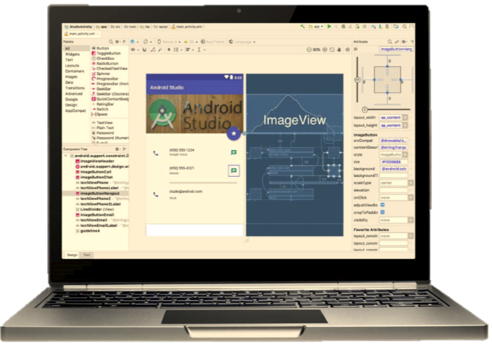
Prerequisites
All you need to do for developing Android application is install IDE called as Android Studio

Slide 13
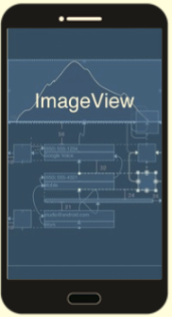
Prerequisites
Android Studio allows to use your Android mobile device as the execution environment

Slide 14
Prerequisites
Android Studio support the mobile phone emulator
You can run this emulator on the other CPU, but it might be too slow

Slide 15
Android Studio
Most famous and powerful IDE for implementing Android Application
Pros
Project management
Support GUI based layout implementing methods
Easy to port the application on the real device
Android mobile phone emulation…
Cons
Emulator is too slow when not using Intel CPU
You can download the installer from here
https://developer.android.com/studio/
This site will detect your OS, and show you a proper download link.

Slide 16
Installation Recommended Specifications
Operating System : Microsoft Windows 10, 8.1, 8, 7
Memory : 8GB
JDK : Java Development Kit (JDK) 7
This material is based on above system specifically 64bit windows system. Please just reference this material and install according to your own system.
Current Android Studio comes with the latest “openJDK” embedded. (So you don’t have to install JDK seperately

Slide 17
Install Android Studio

Slide 18
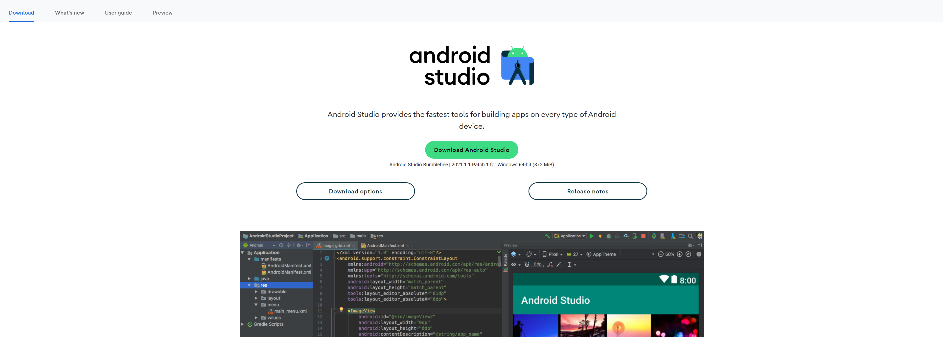
Get Android Studio install file
You can download Android Studio install file at below link. https://developer.android.com/studio?hl=ko

Slide 19
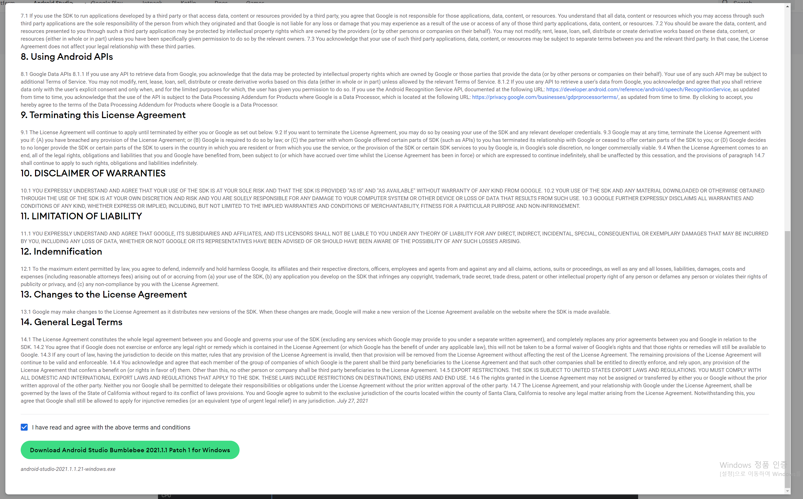
Install Android Studio

Slide 20
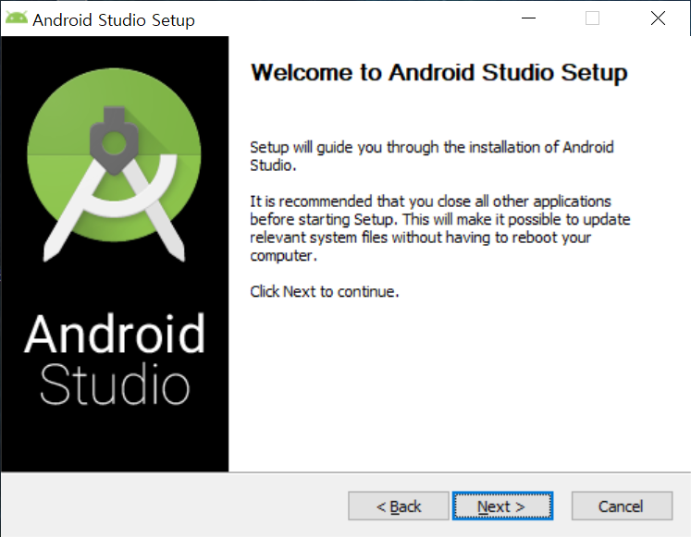
Install Android Studio

Slide 21
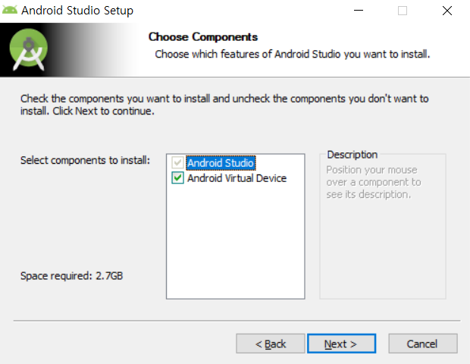
Install Android Studio

Slide 22
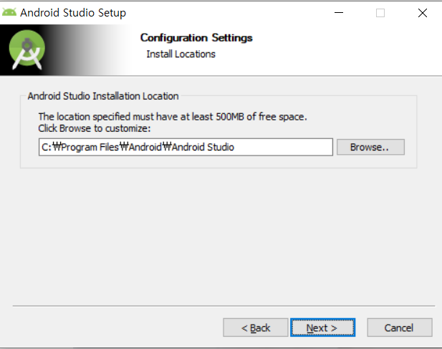
Install Android Studio

Slide 23
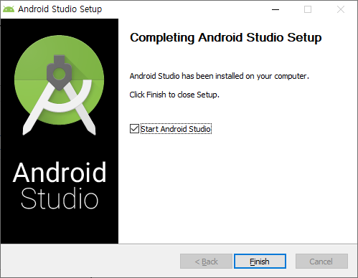
Install Android Studio
You can start new Android project with “Start a new Android Studio project”

Slide 24
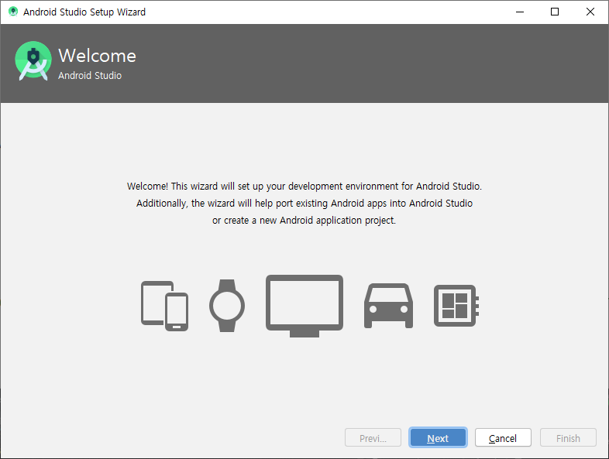
Install Android Studio

Slide 25
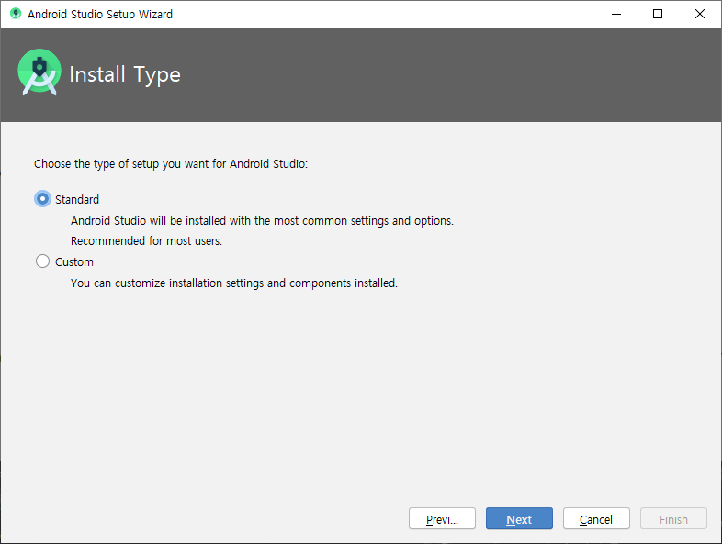
Install Android Studio

Slide 26
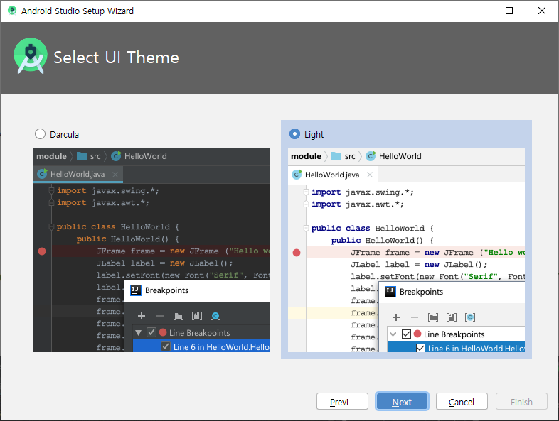
Install Android Studio
🡪 Choose any theme you want!

Slide 27
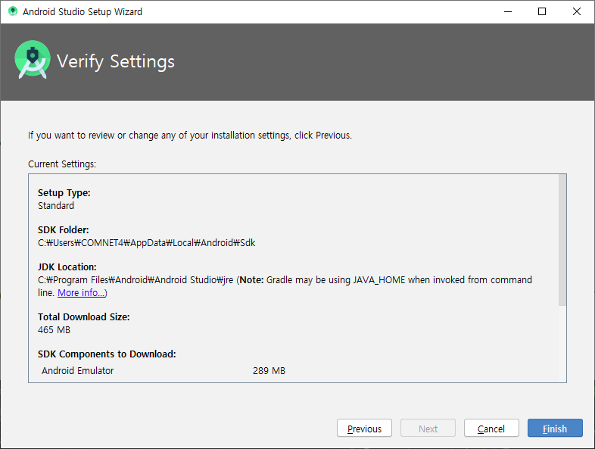
Install Android Studio

Slide 28
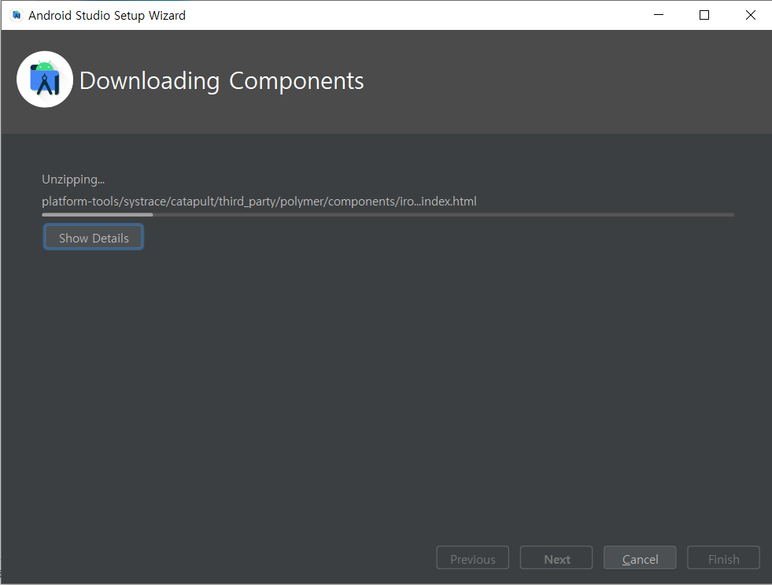
Install Android Studio

Slide 29
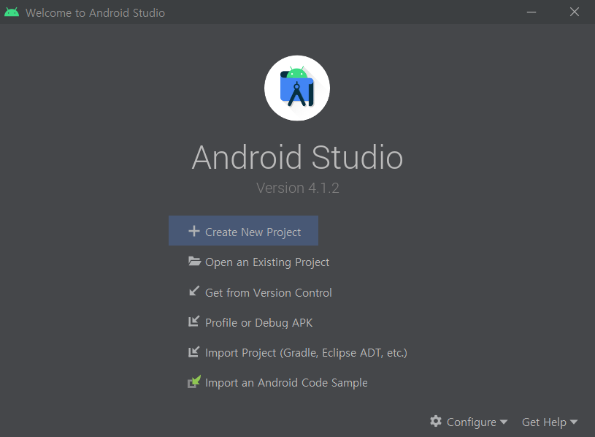
Install Android Studio
Click to create
New Project

Slide 30
Hello world tutorial

Slide 31
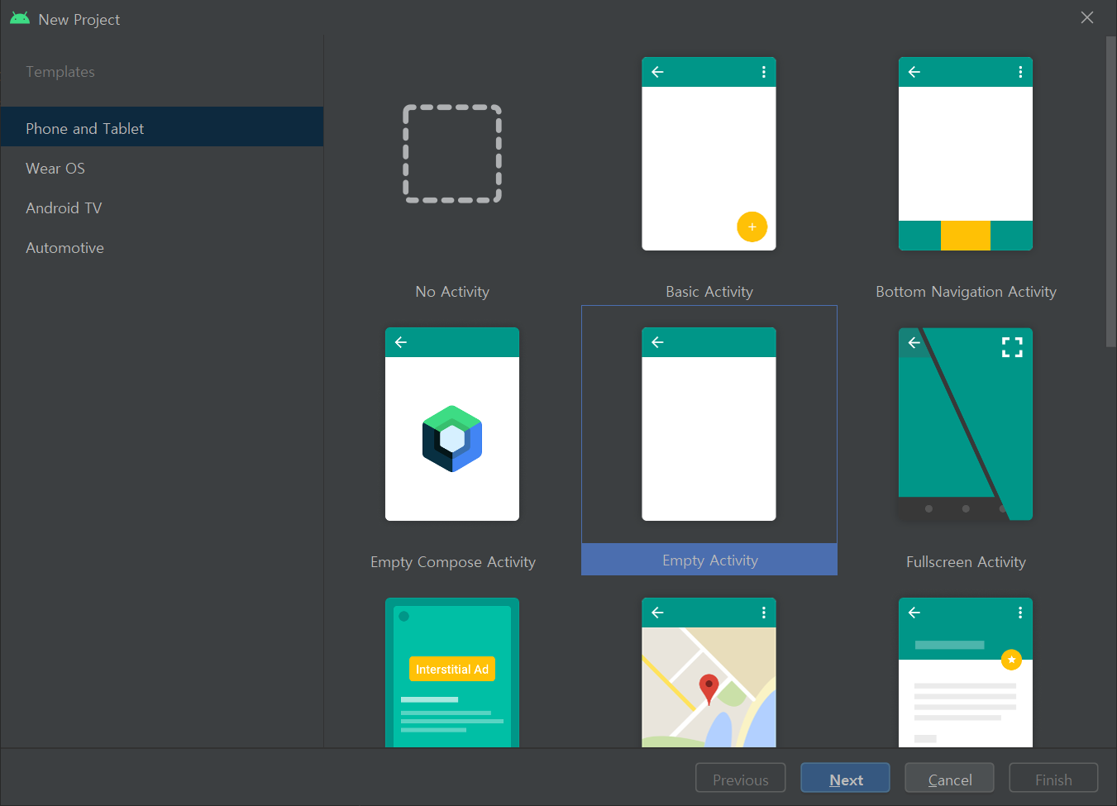
Choose your project

Slide 32
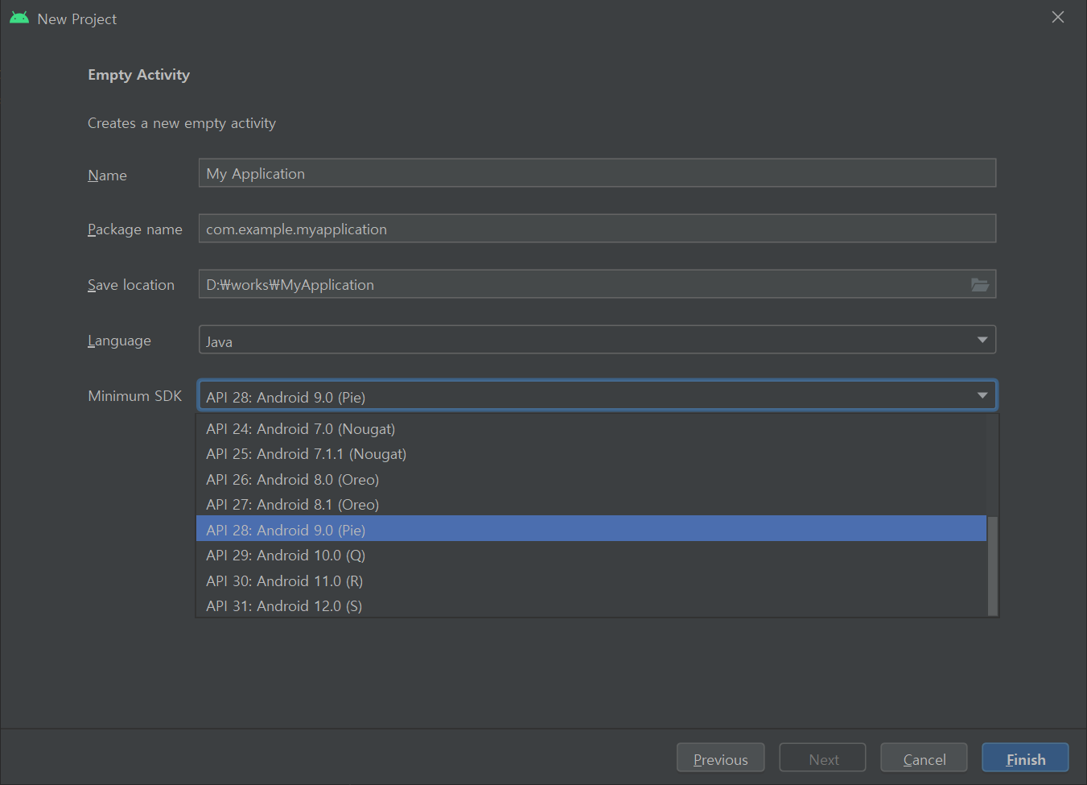
Configure your project
You have to choose Java
Instead of Kotlin
Can Choose minSDK here!

Slide 33
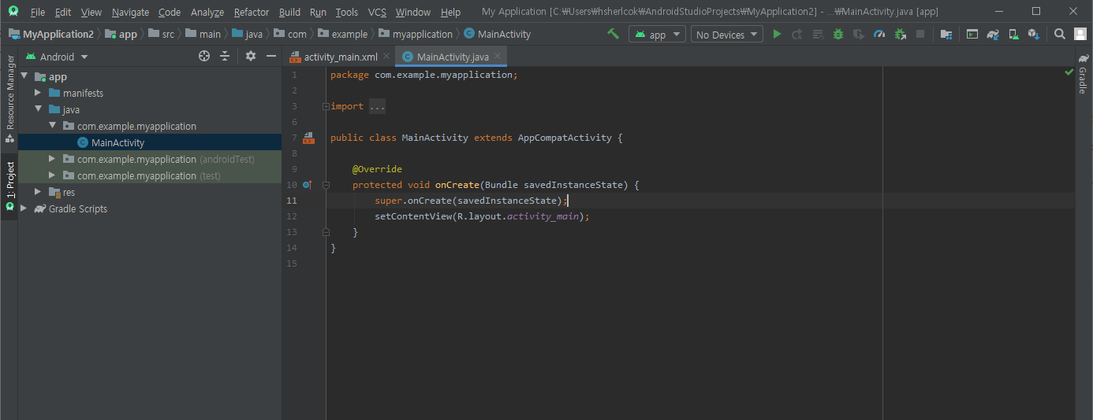
Start new project
Or Clich here !
When you made Android Studio project, it automatically made Hello World tutorial.
To run project, Alt+Shift + F10

Slide 34
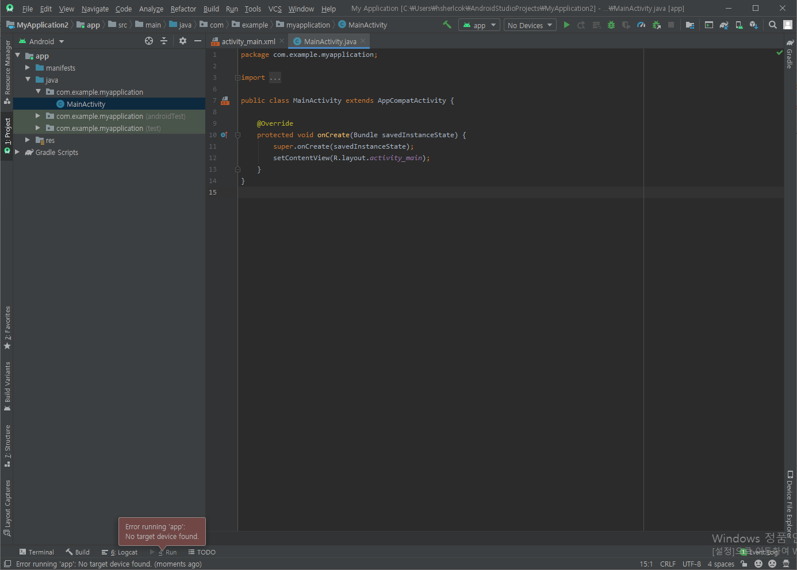
Start new project
Click here to
create new virtual machine
If you don’t have any virtual device,
this message will be shown…

Slide 35
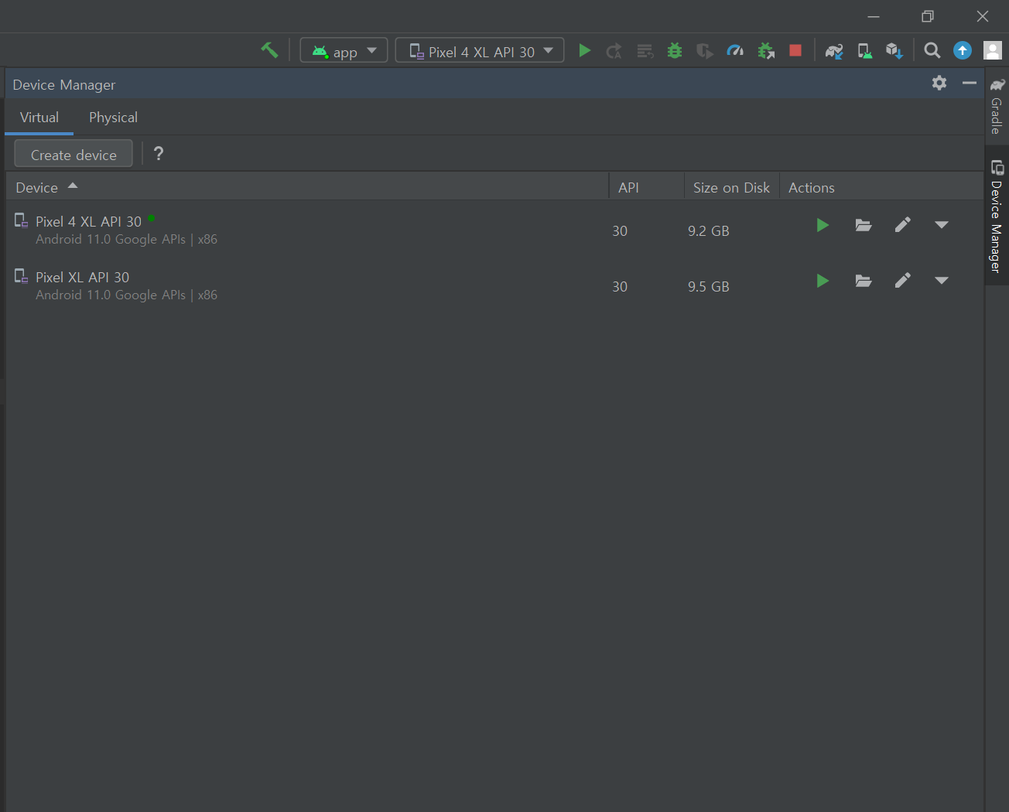
Select Deployment Target
-> Ignore already generated one,
Create new one!

Slide 36
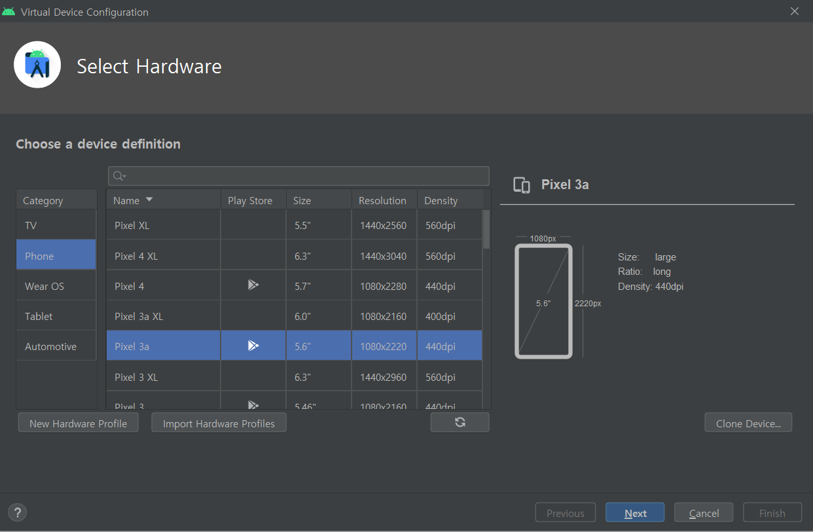
Virtual Device Configuration
🡪 Choose any Phone Device you want.

Slide 37
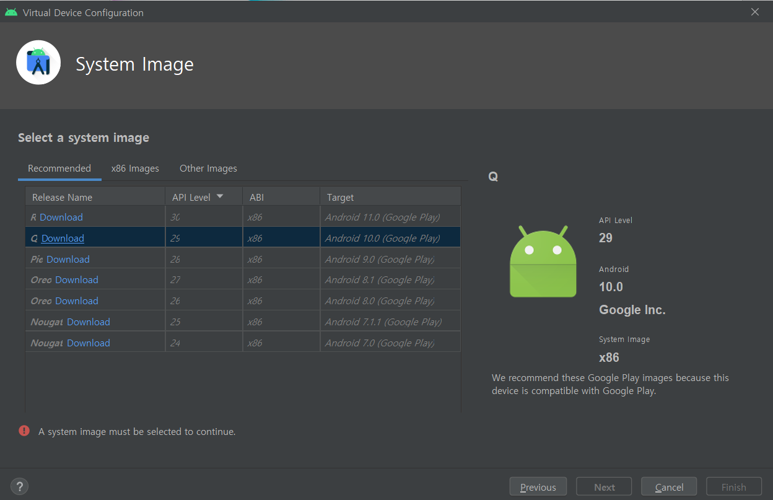
Virtual Device Configuration Intel CPU Computer
Android 11 is the latest version,
But we only use Android 10 in this class

Slide 38
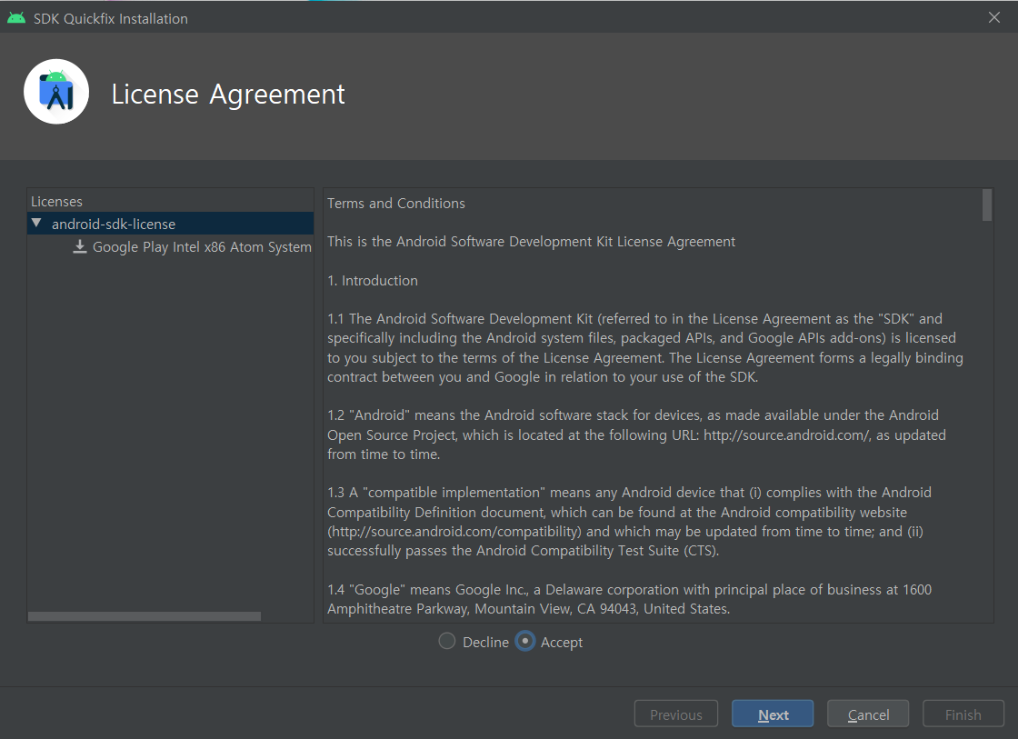
Virtual Device Configuration
Click Here
🡪 You have to accept to all licenses here

Slide 39
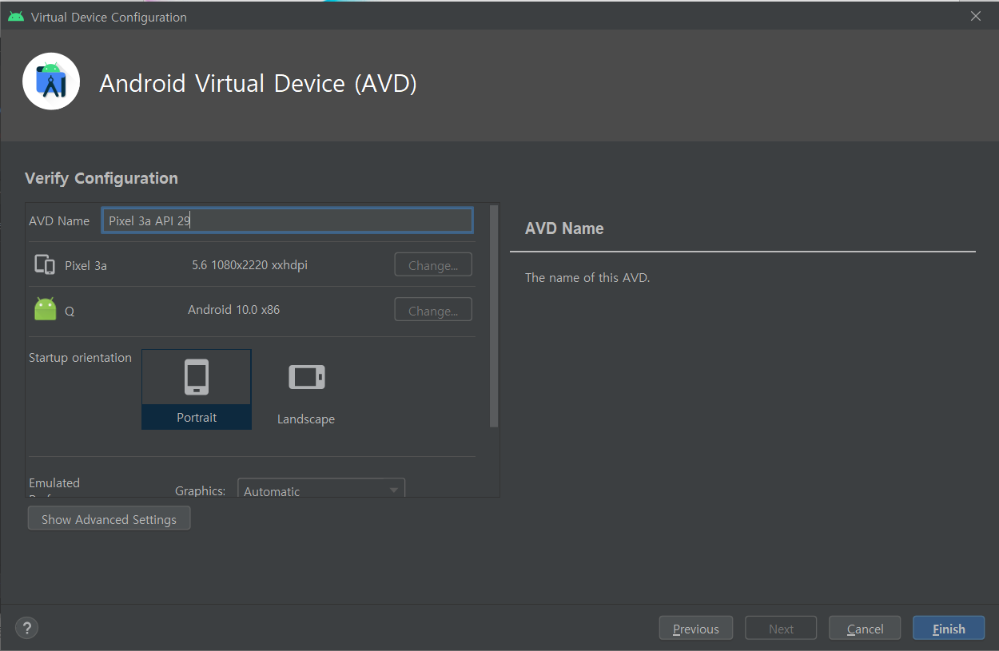
Virtual Device Configuration - Optional

Slide 40
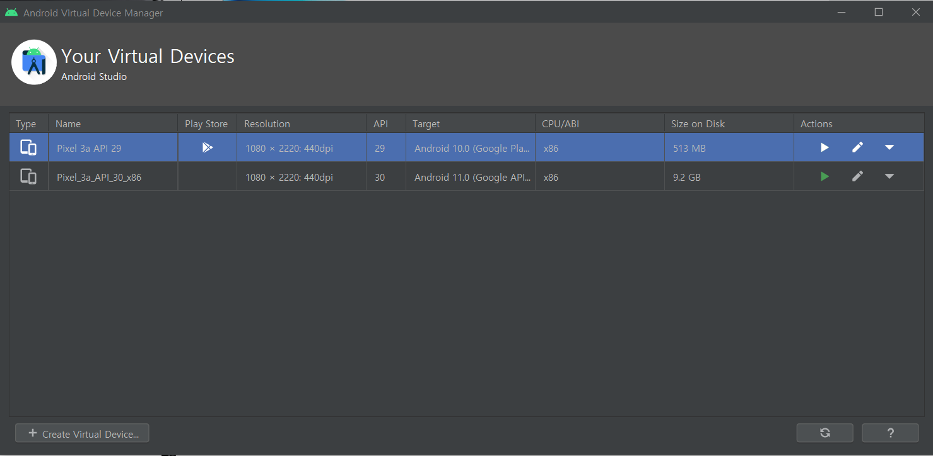
Virtual Device Configuration - Optional

Slide 41
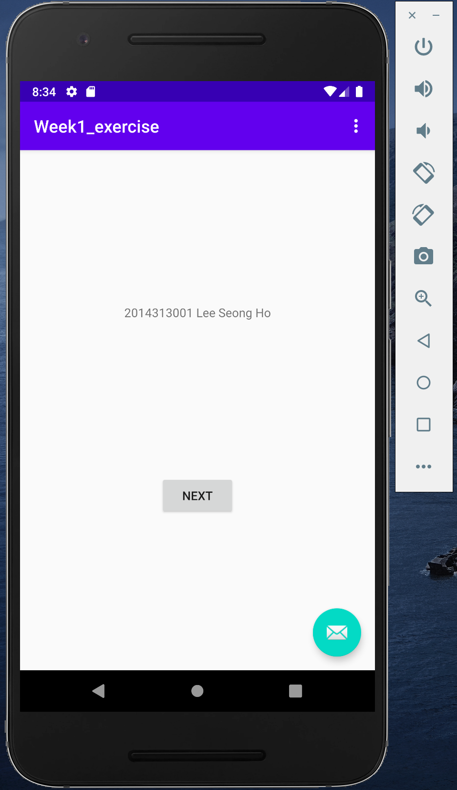
[Week Assignment #0]
Make Project which contains basic Activity
Package name should be
“edu.skku.MAP.WA0”
Modify ‘Hello World!’ text to
[Your Student ID] [Your Name]
Submit screenshot of your emulator
As shown in the right picture
Or… Show us your emulator in the class

Slide 42
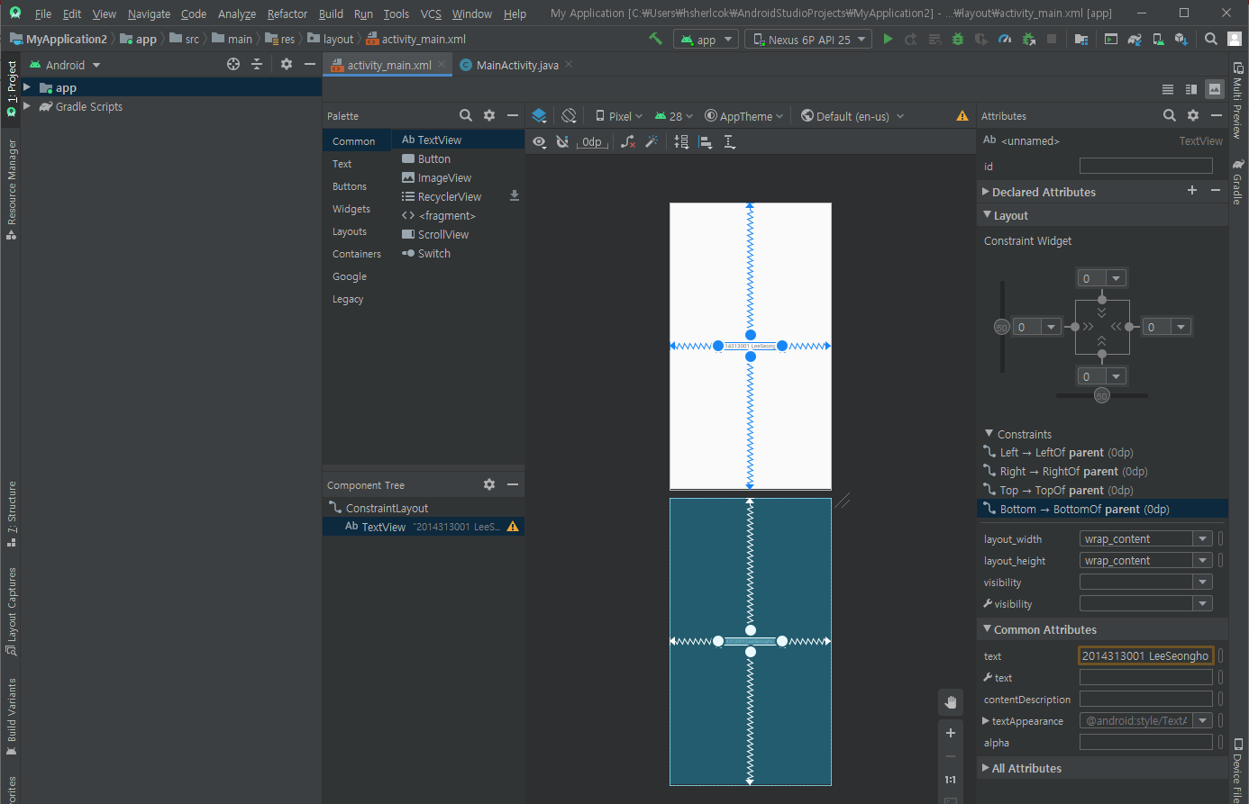
[Week Assignment #0]
Hint) You can change text from
You Can
modify text here

